Slide 1
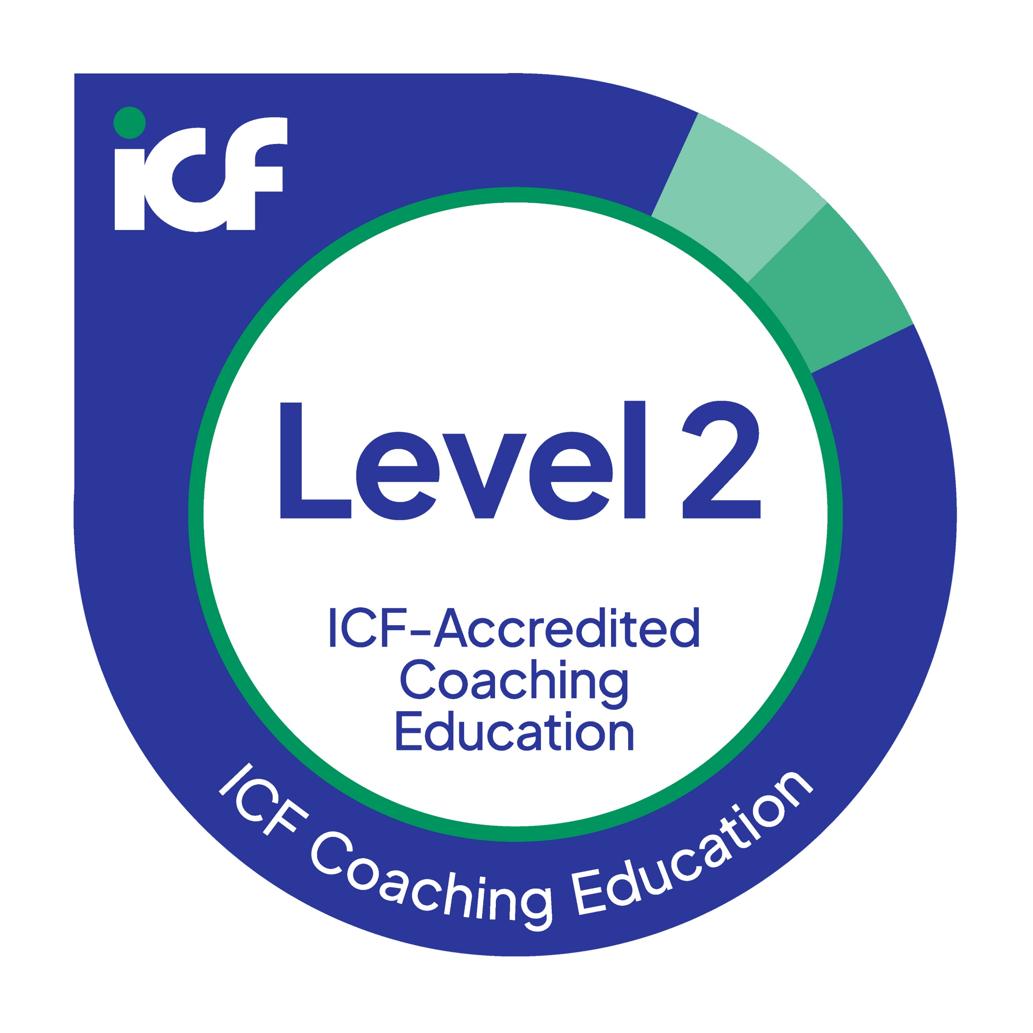

Module: Inner Work – The EFI
Inner Work Coaching with the EFI
Your Benefits
A compact training program in working with the EFI as a foundation for supporting individuals, teams, and organizations through change, accredited by the ICF (26 CCEs).
Contents
  Theoretical and scientific foundations of the FiRE model
  Indications and contraindications
  Scientific Basis
  Structure and Functioning of the EFI
  The eight Spheres of Resilience
  Professionally debriefing EFI results
  Guiding clients in reflection and development
  Certification based on the EFI exam
  Peer debriefing of one’s own EFI profile
  Three EFI profiles for practice coaching sessions
Methods
  Interactive approach
  Exchange and dialogue
  Review learning through quizzes
  In-depth learning through practical examples,
  demo debriefings, and case studies
  Peer exchange to ensure confident application in your own coaching practice
Scope
17.5 hours synchronous
(Kickoff; 4 x 4-hour workshops)
8.5 hours asynchronous
(Preparation, EFI debriefings)
Your Lead Coaches
Karsten Drath (ICF PCC)
Carolin Zeller (ICF PCC)

